Slide 1
Opening Indian Restaurant in Edmonton, Alberta
Amanpreet Kaur

Slide 2
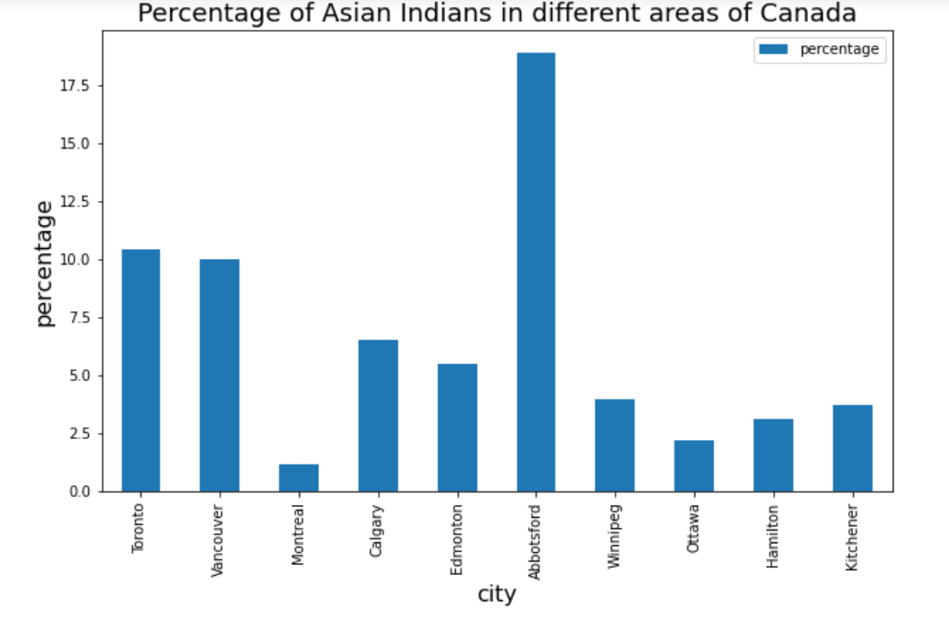
Why Indian, Why Edmonton?
1. India - by far the main source country of new immigrants to Canada in 2019.
2. Cities like Toronto, Vancouver, Montreal, Calgary, Edmonton, Abbotsford etc have large Asian Indian population.

Slide 3
Data Sources
Geographical coordinates of Alberta(using Nominatim)
Longitude and Latitude values of all the neighbourhoods of the borough Edmonton (source 'https://en.wikipedia.org/wiki/List_of_postal_codes_of_Canada:\_T')
Data about the neighbourhood having the largest percentage of Asian Indian population out of all the neighbourhoods(source - https://citymuseumedmonton.ca/2016/11/22/edmontons-south-asian-community/)
Information about all the Indian Restaurants in that neighbourhood, their ratings, tips and nearby venues (using foursquare app)

Slide 4
Data Cleaning
The data containing information about the postal codes of all the boroughs and neighborhoods of Alberta along with there longitude and latitude values downloaded.
‘Not Assigned’ value rows dropped.
Rows with same postal codes joined.
Longitude and Latitude columns converted to numeric datatypes
Edmonton data fetched.

Slide 5
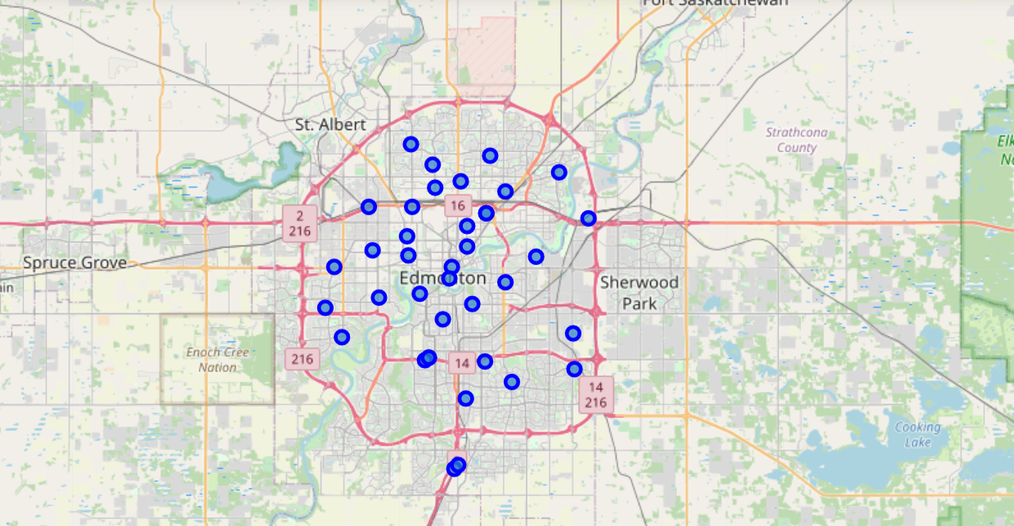
Map of Edmonton with neighborhoods superimposed on top

Slide 6
Neighborhood with maximum Indian population
From the following link, it is seen that 'Mill Woods' is the neighborhood where most of the South Asian community resides.
https://citymuseumedmonton.ca/2016/11/22/edmontons-south-asian-community/

Slide 7
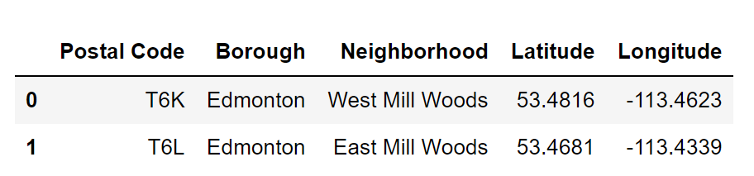
Mill Woods data

Slide 8
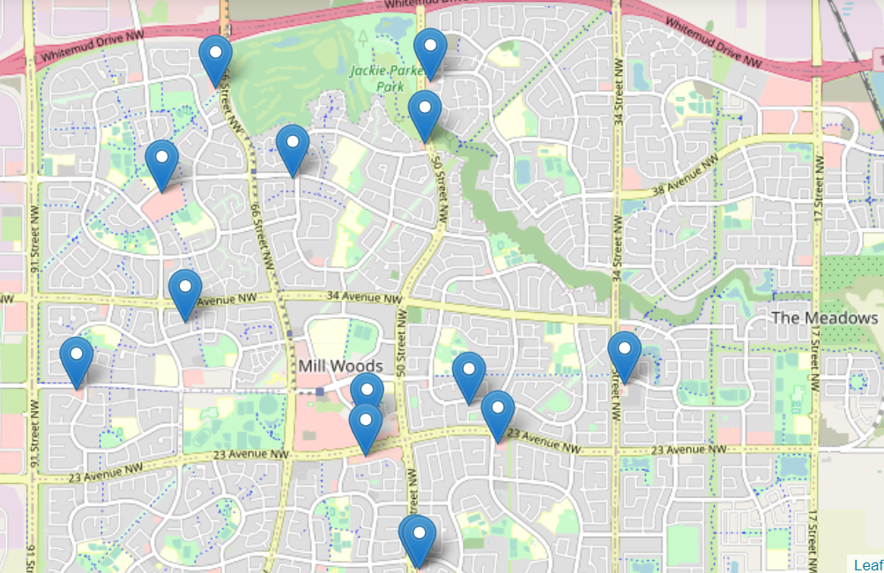
Indian Restaurants within 2500m radius of Mill Woods

Slide 9
Ratings of all the Indian Restaurants
Using the Foursquare App
using the url- 'https://api.foursquare.com/v2/venues/{}?client_id={}&client_secret={}&v={}'.format(venue_id, CLIENT_ID, CLIENT_SECRET, VERSION) result = requests.get(url).json() try: print(result['response']['venue']['rating']) except: print('This venue has not been rated yet.').
Surprisingly, not even a single restaurant out of all it rated yet

Slide 10
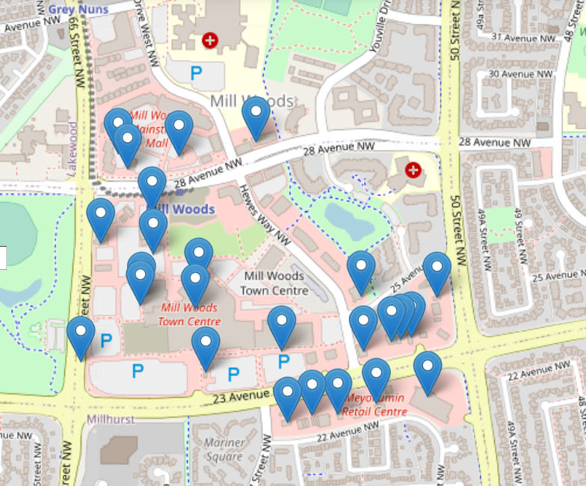
Other trending venues nearby
Coffee Shops
Fast food restaurants
Banks
BBQ joints
Convenience stores
Gas station
Business services
Community centre

Slide 11
Conclusion
From the data on Indian population in Edmonton - Mill Woods, ratings of different Indian Restaurants and trending venues, it can be seen that opening of Indian Restaurant in the Mill Woods Town Center, Mill Woods, Edmonton will be a Profitable business.

Slide 12


